Slide 1
Rockbuster Stealth
Ryan Cemazar
From Brick and Mortar to Online
09/4/2023
1
#1

Slide 2
Overview
01
Where are our customers located?
02
Which film categories are the most popular?
03
Which movies are the most popular?
04
Who are our top customers?

Slide 3
By The Numbers
Customers
Movies
Countries
Average Rental Rate
Average Rental Duration
Average Film Length
599
1000
108
$2.98
5 Days
115 Minutes

Slide 4
Where are our customers located?
01

Slide 5
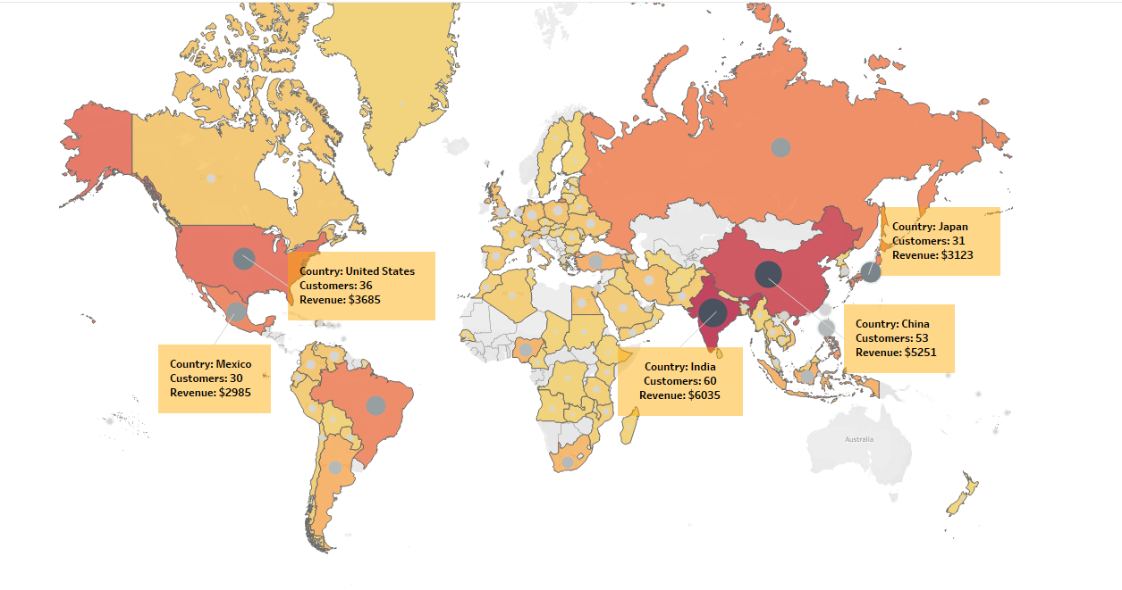
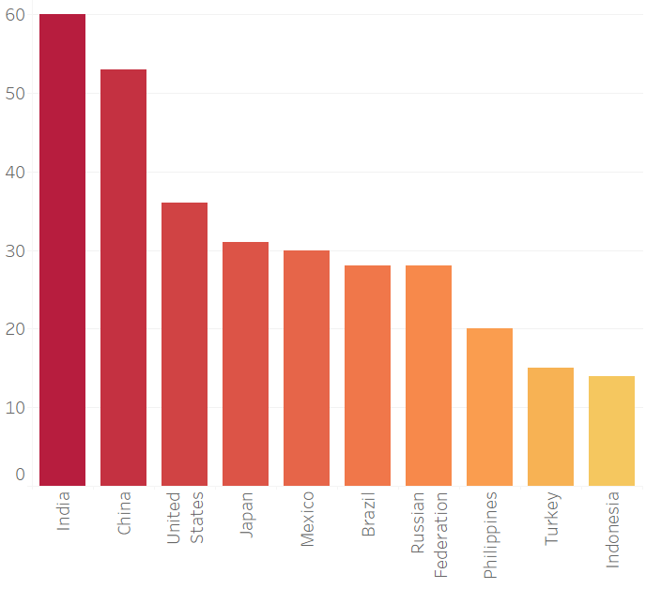
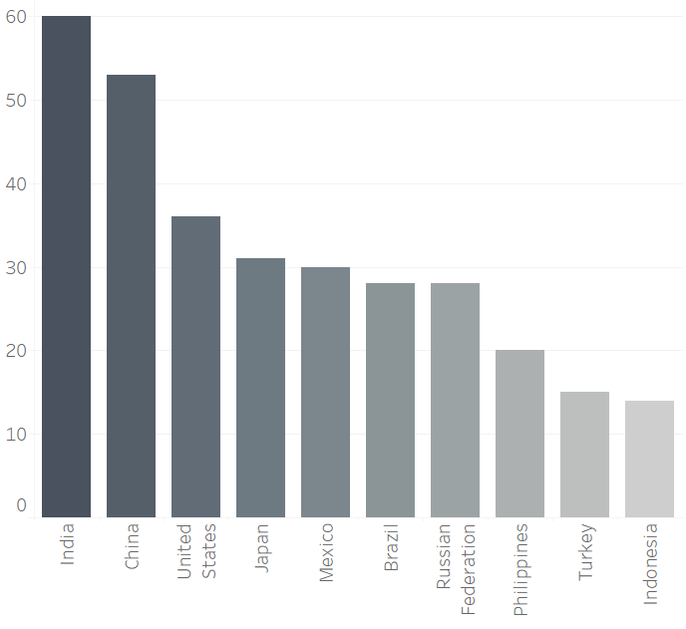


Customer and Revenue Map
Customers
Revenue
Tableau Link

Slide 6
Geographic Customer Breakdown
The Top 5 Countries are home to 35% of Rockbuter’s customers around the world.
The Top 5 Countries are responsible for 34% of Rockbuster’s total revenue.
Focusing on retaining these locations will be key to Rockbuster’s success in moving to a digital platform.

Slide 7
Which film categories are the most popular?
02

Slide 8
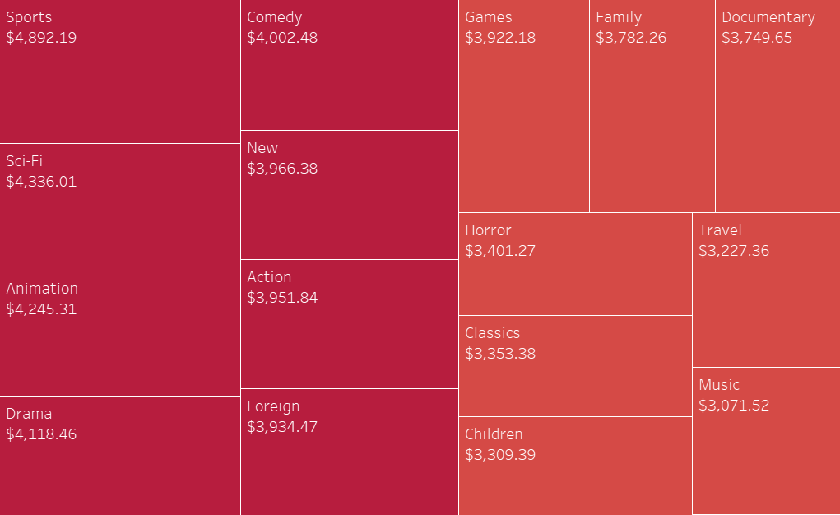
Revenue by Genre
The Top 5 Movie Categories by Revenue are:
1. Sports
2. Sci-Fi
3. Animation
4. Drama
5. Comedy
Tableau Link

Slide 9
Which Genres bring in the most revenue per film?
The Top 5 Genre Categories are responsible for 35% of Rockbuster’s revenue.
Are some categories high or low earners because they have more or less total titles available to rent?
Determining this will help us to know which categories to invest more or less money in as we switch to streaming.

Slide 10
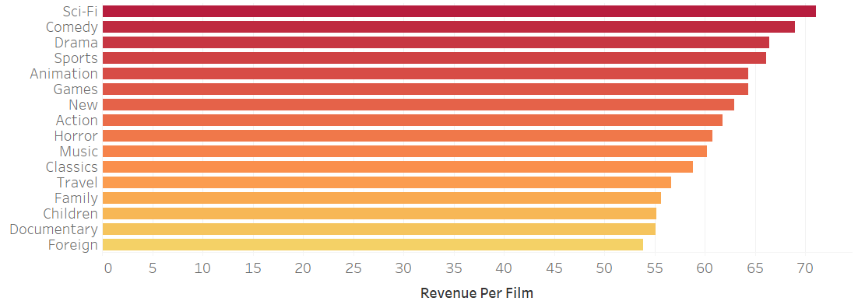
Revenue Per Film by Genre
$
The Top 5 overall genres per number of films are:
1. Sci-FI
2. Comedy
3. Drama
4. Sports
5. Animation
Tableau Link

Slide 11
Which Genres bring in the most revenue per film?
So are certain categories higher earners because they have more titles?
The Top 5 overall genres per number of films are:
1. Sci-FI
2. Comedy
3. Drama
4. Sports
5. Animation
The Top 5 Movie Categories by Revenue are:
1. Sports
2. Sci-Fi
3. Animation
4. Drama
5. Comedy
As we can see, the Top 5 Categories by Overall Revunue and Revenue per Number of Films are the same, but in a slightly different order.

Slide 12
Which movies are the most popular?
03

Slide 13
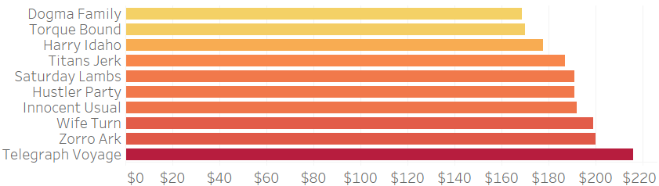
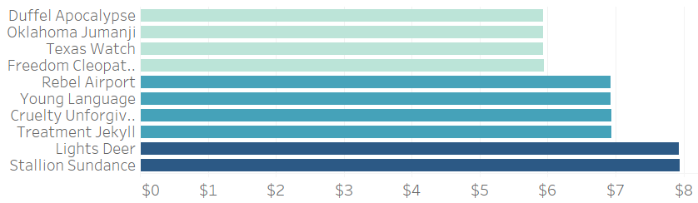
Revenue by Movie
The Top 10 Movies bring in 28x more revenue than the Bottom 10
Tableau Link

Slide 14
Who are our Top Customers?
04

Slide 15
Top 10 Customers
Customer ID | First Name | Last Name | City | Country | Total Amount Paid
148 | Eleanor | Hunt | Saint-Denis | Runion | $211.55
526 | Karl | Seal | Cape Coral | United States | $208.58
178 | Marion | Snyder | Santa Barbara dOeste | Brazil | $194.61
137 | Rhonda | Kennedy | Apeldoorn | Netherlands | $191.62
144 | Clara | Shaw | Molodetno | Belarus | $189.60
459 | Tommy | Collazo | Qomsheh | Iran | $183.63
181 | Ana | Bradley | Memphis | United States | $167.67
410 | Curtis | Irby | Richmond Hill | Canada | $167.62
236 | Marcia | Dean | Tanza | Philippines | $166.61
403 | Mike | Way | Valparai | India | $162.67
The Top 10 Customers are responsible for 3% of Rockbuster’s Total Revenue

Slide 16
How valuable are our Top Customers?
The Top 10 Customers bring in 3% of Rockbuster’s Total Revenue
The Top 50 Customers bring in 13% of Rockbuster’s Total Revenue
Rewarding our Top Customers helps to ensure they will stay with Rockbuster as we transition to our digital streaming platform.

Slide 17
Review and Recommendations
The Top 5 Countries are home to 35% of Rockbuster’s customers and 34% of Rockbuster’s Revenue.
The Top 5 Genre Categories are responsible for 35% of Rockbuster’s revenue.
Prioritizing these countries is key to Rockbuster’s future success.
The Top 50 Customers bring in 13% of Rockbuster’s Total Revenue .
Creating a loyalty rewards program for our Top Customers will ensure they stay with us as we transition to on online streaming platform.

Slide 18
Thank you!
Do you have any questions?
RyanC@Rockbuster.com
555-1212
RockBusterRentals.Com

Slide 19
Credits.
Presentation Template: SlidesMania
Sample Images: Unsplash
Fonts used in this presentation: Questrial and Rubik

